Slide 1
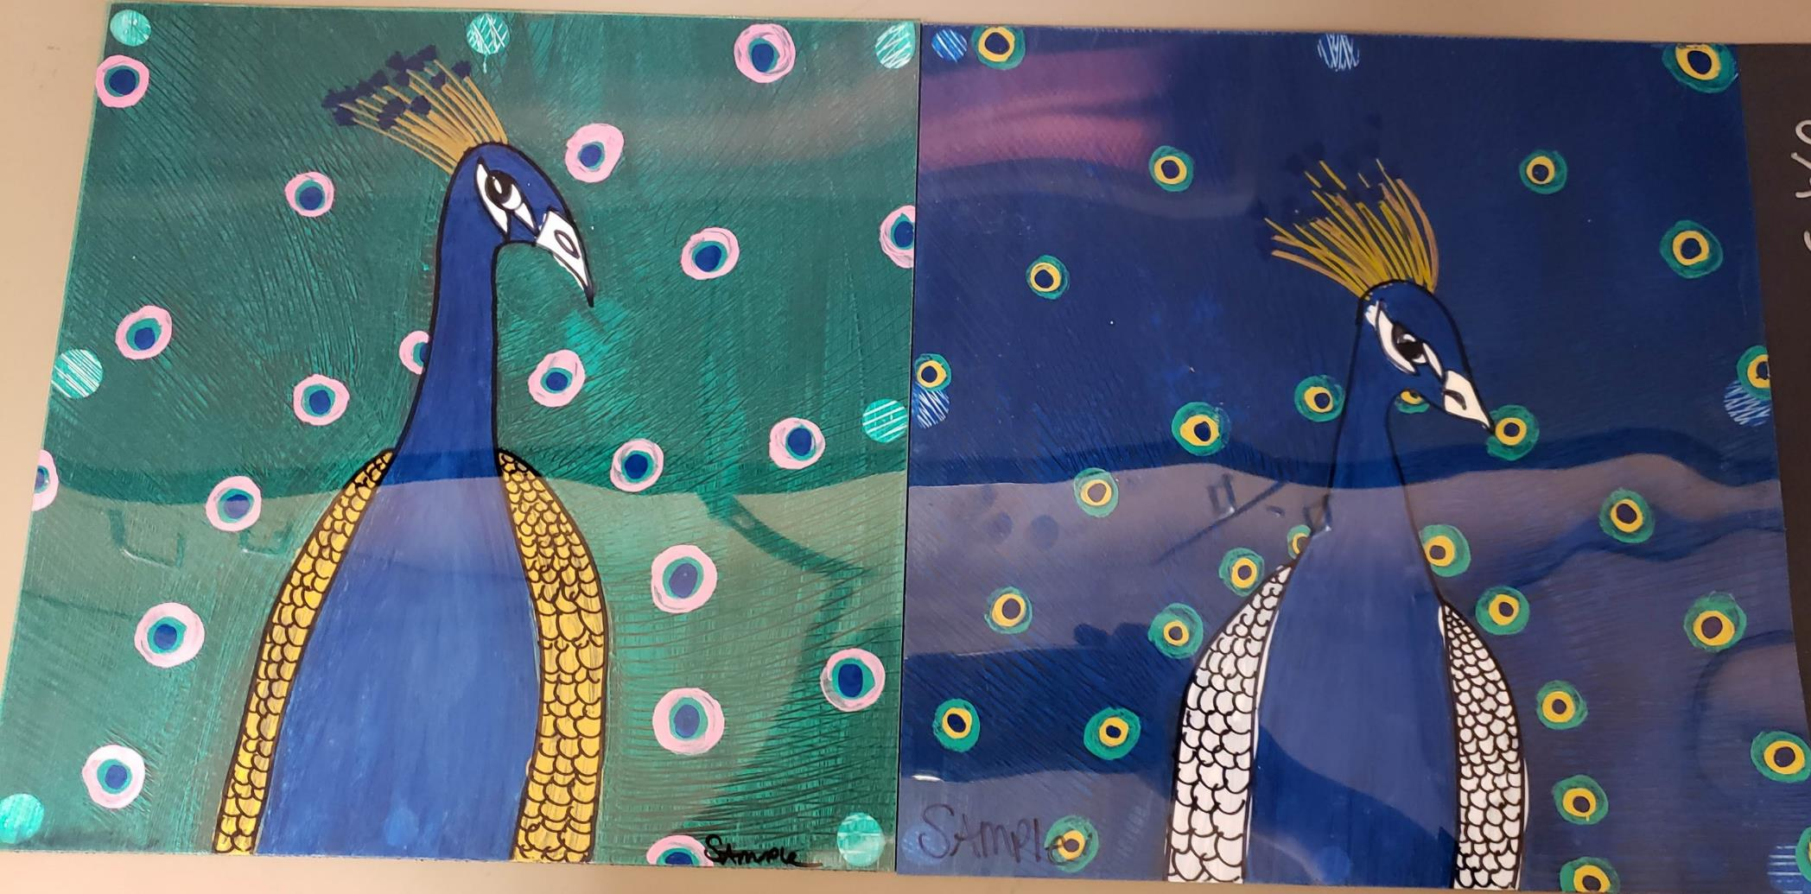
Peacock on acetate with metallics
Study on Visual Texture
Written by Kari Feistner (Edited by Docents)
Creekside Elementary

Slide 2
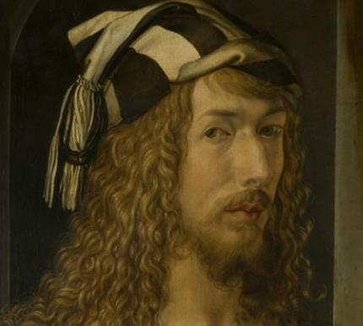
Albrecht Durer (1471-1528) was a German Painter, printmaker, and mathematician. He was regarded as the greatest German Renaissance Artist. His drawings and paintings show amazing detail displaying visual texture. Here are a couple of his famous pieces.
“Wing of A Roller” Durer
Look at the repeated lines creating the wings.
“Durer Hare Engraving”
How do you think it would feel if you touched this rabbit?
How long do you think it took him to create the fur?

Slide 3
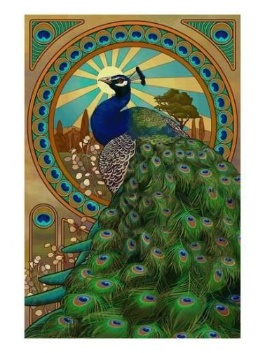
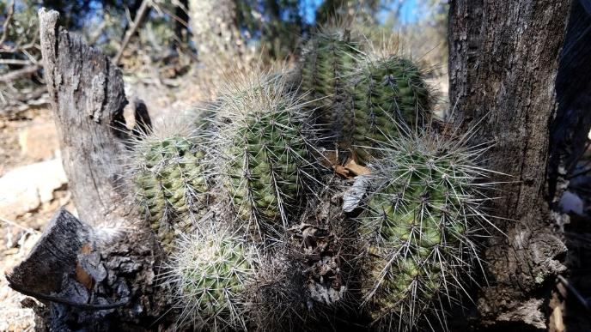
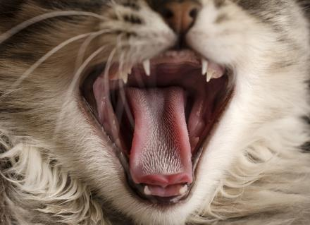
Texture
Texture refers to the surface quality in a work of art. We associate textures with the way things look or feel.
Visual Texture is how something looks like if feels.
Artists create visual texture by repeating shape, line, value and color. (Durer’s images on right…feathers look soft, wing looks smooth, rabbit looks fluffy)
Actual Texture is how something feels when you touch it. (rocks are smooth, cactus is prickly, cat’s tongue is rough)

Slide 4
What kinds of lines does Durer use to create the rough texture of the Rhino’s skin?
This piece was drawn by Durer from a written description of a Rhino. He never saw one in real life!

Slide 5
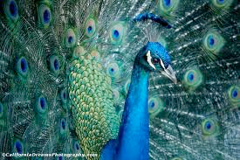
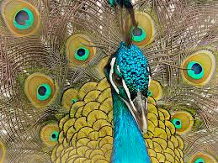
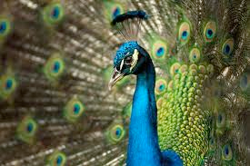
Observe the lines in the photos of these Peacocks.
They overlap and repeat themselves.
These are actual photos of peacocks showing actual texture.

Slide 6
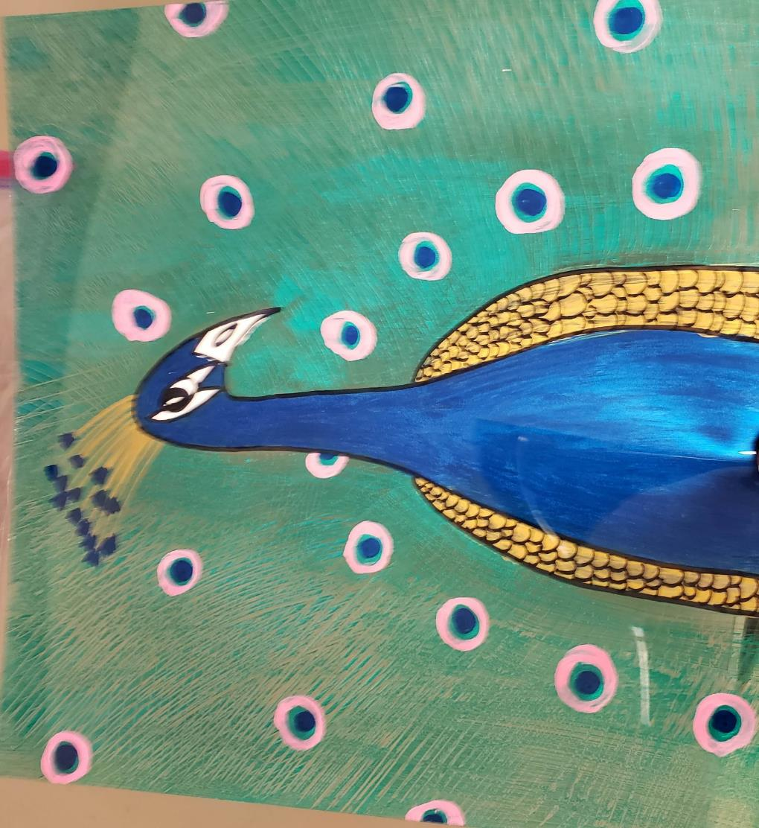
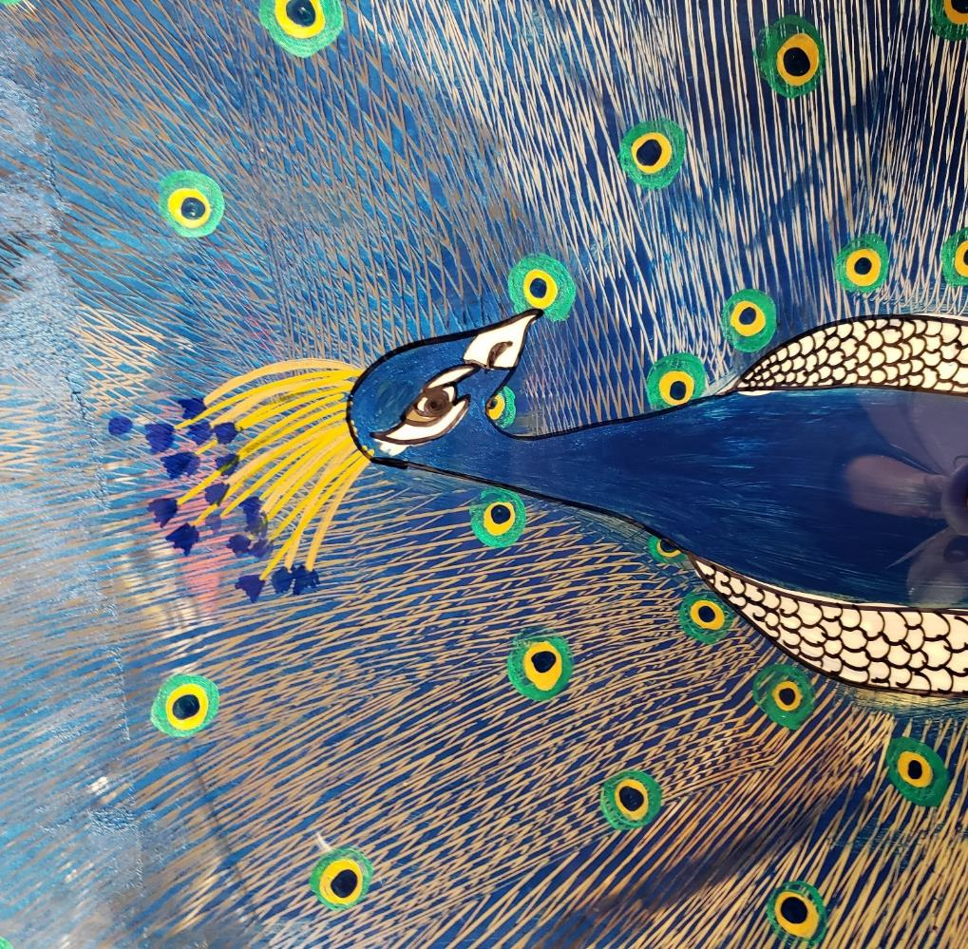
Peacock on acetate with metallics
Study on Visual Texture

Slide 7
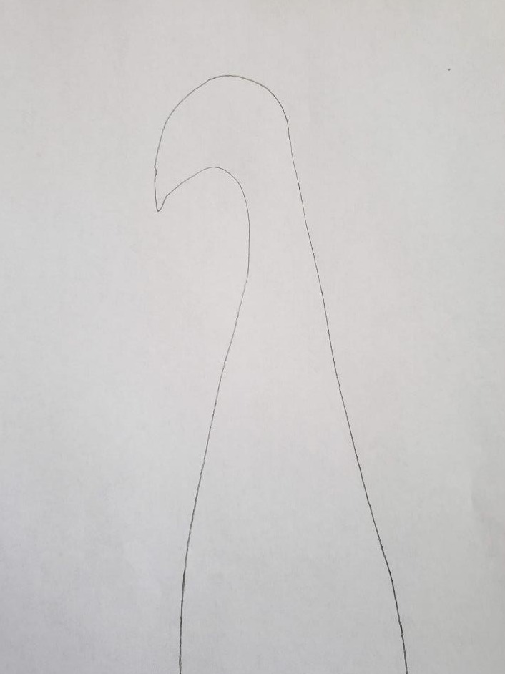
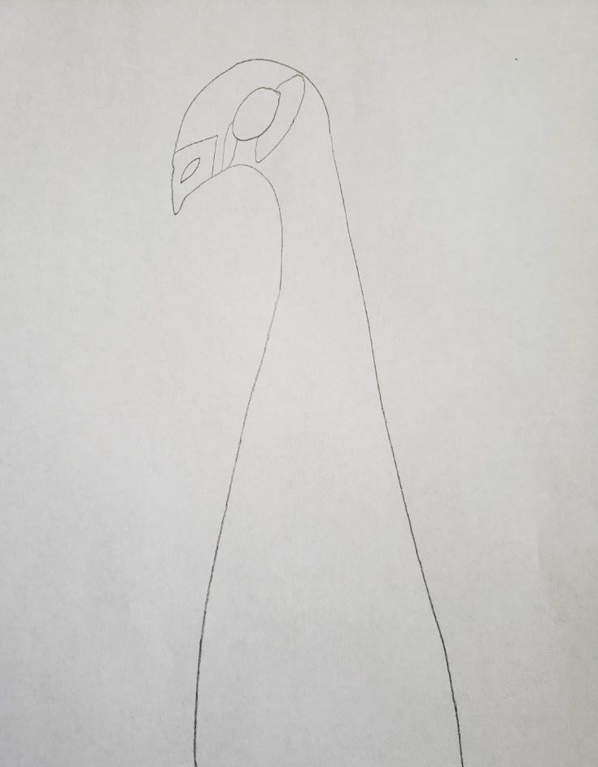
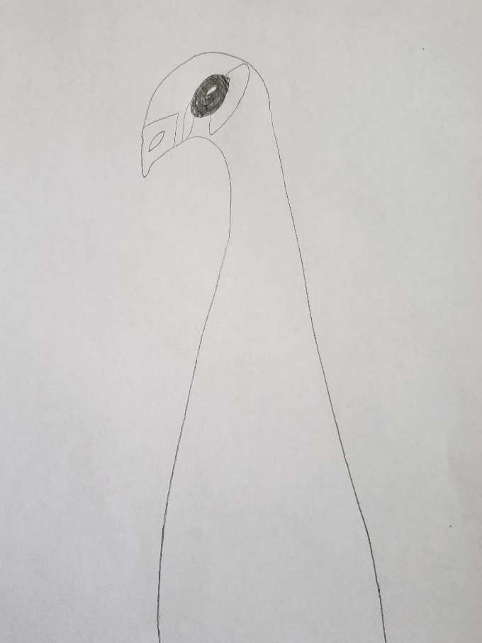
Draw Your Bird on your white paper with a pencil.
Make a long skinny neck using a profile view of your peacock face.
Or
Choose to trace with the template

Slide 8
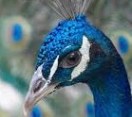
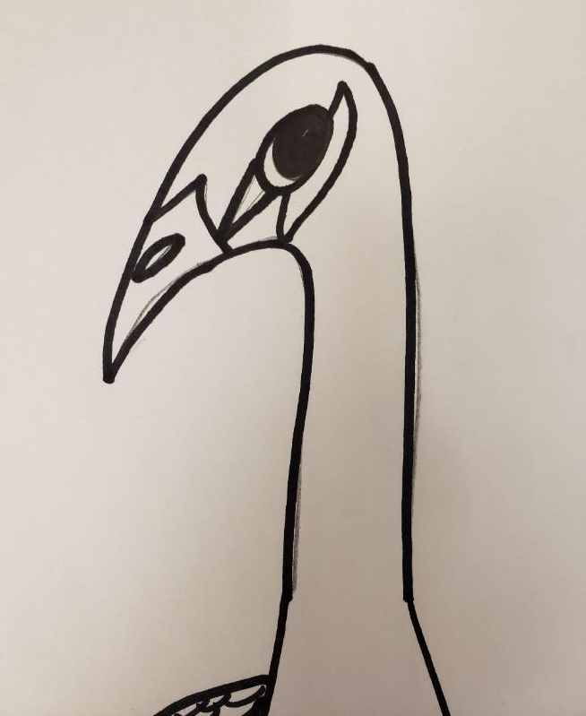
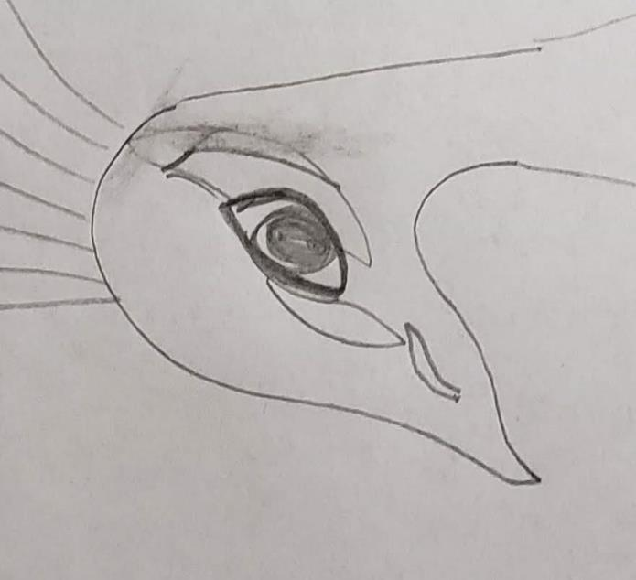
Add an Eye.
Be creative with the eye!
Here are some examples.
Draw the beak as well.
Don’t worry about it being perfect.
We will be tracing this onto our acrylic sheet and tossing the paper.
Do not draw the top feathers.
Notes:
Students will draw on a plain white paper. Use the overhead to demonstrate how to draw the body, emphasizing the skinny neck and becoming larger and wider at bottom. Watching someone do this first can be helpful. Show the next slide for a brief example of various eyes they could create. Emphasize the eye has a larger circle around and needs to have enough space to paint in. Can switch back to this slide and let the students use as a guide while they finish all the steps listed.

Slide 9
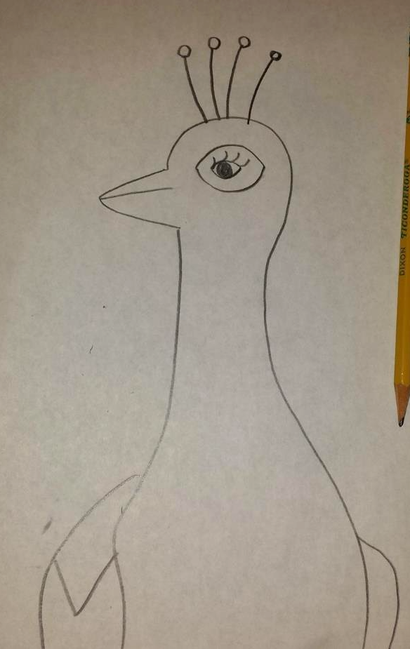
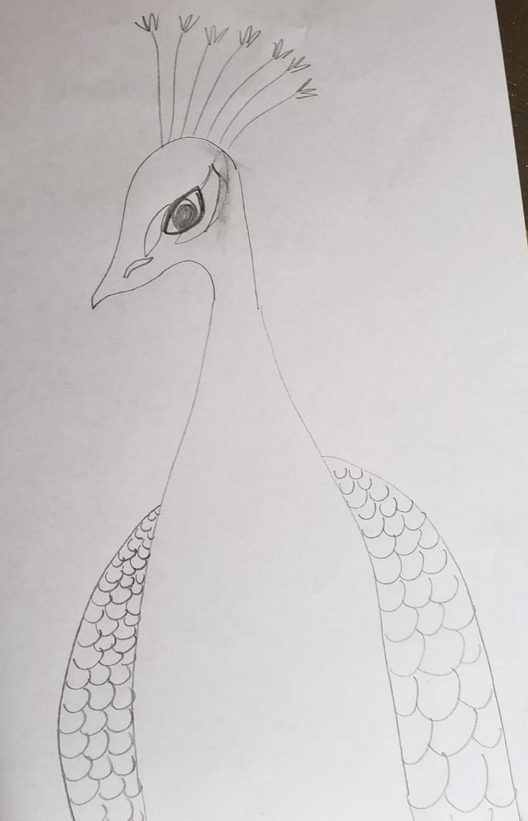
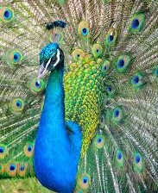
Create Detail
Add wings on each side of the body.
2. Create visual texture by repeating lines or patterns. Use curves, zig zags or wavy lines.
Notes:
Encourage kids to make their own unique eye shape.

Slide 10
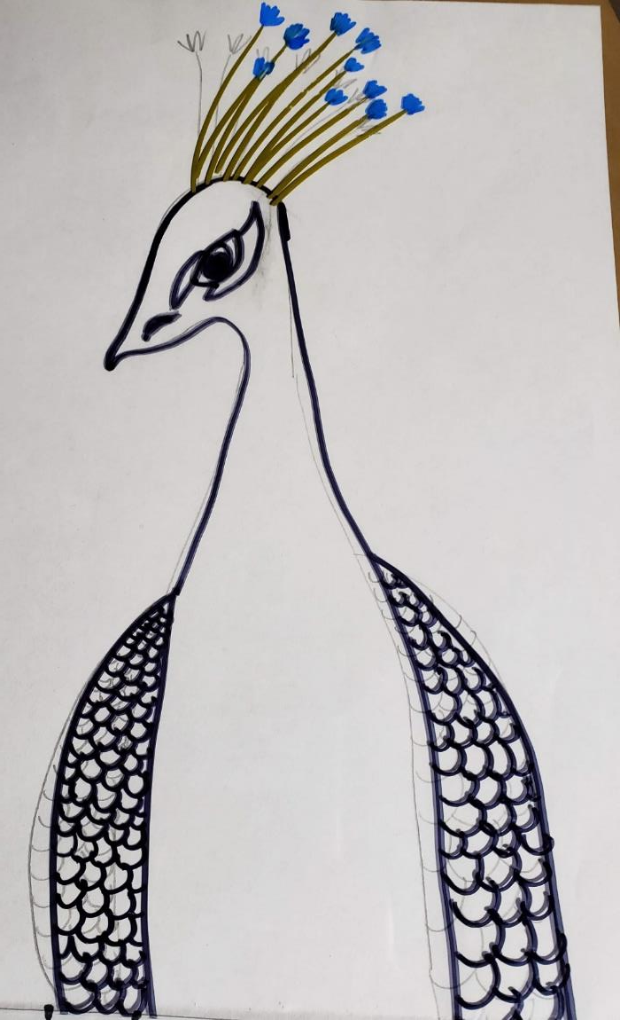
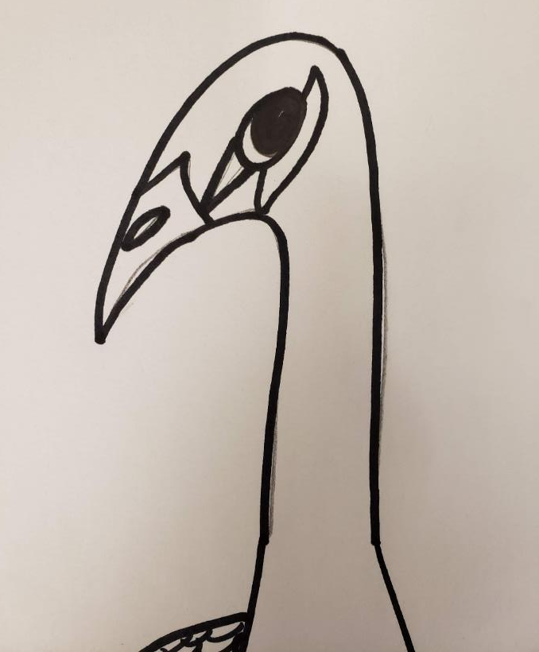
Trace Drawing Onto Plexiglass
Write your name on the plexiglass.
Place drawing over plexiglass.
Trace using black sharpie.
Fill in beak hole and eyeball with black.
Do. Not trace the crest.

Slide 11
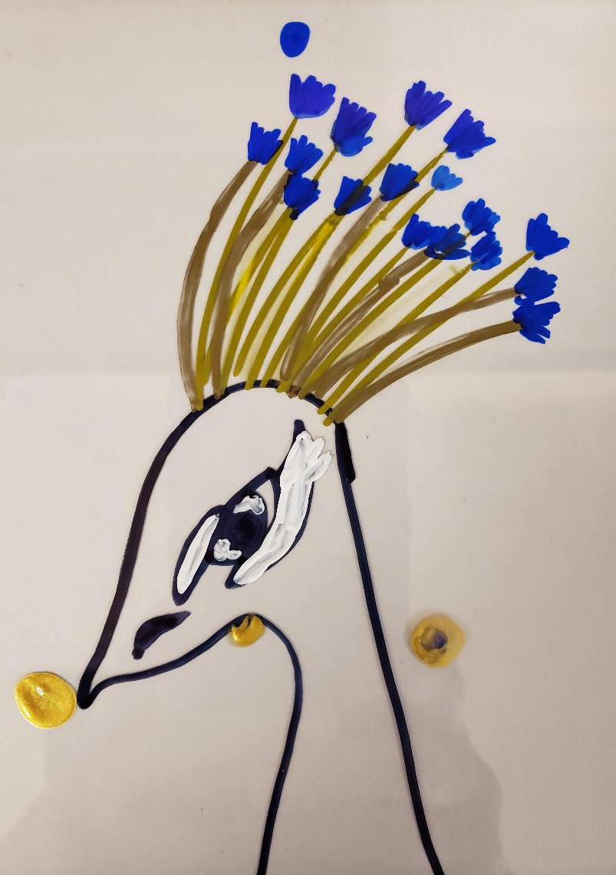
Draw the crest
Using a gold sharpie start drawing lines off the top of the head up toward the edge of the plexiglass.
Try to keep the gold pen on the black tracing line.
Add a blue fuzzy feather or star to the top of the gold lines.

Slide 12
Another reminder of what a Peacock looks like.
Notes:
Might let students know the paint will be see-through (you’ll see the blue underneath and that’s okay).

Slide 13
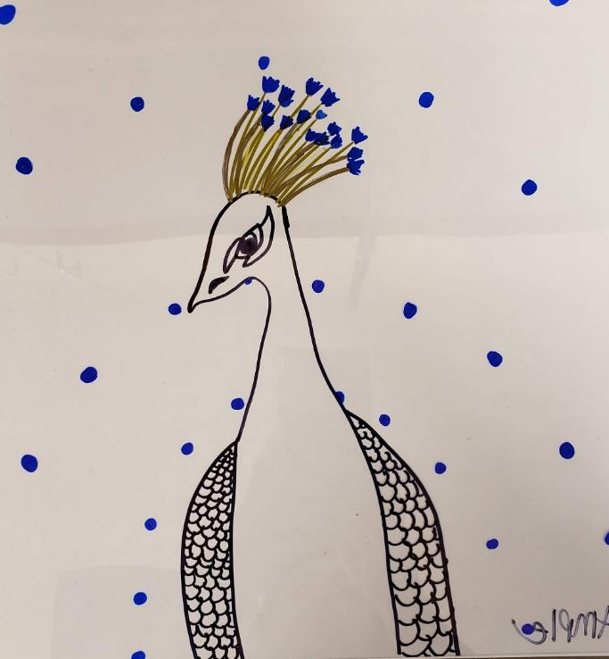
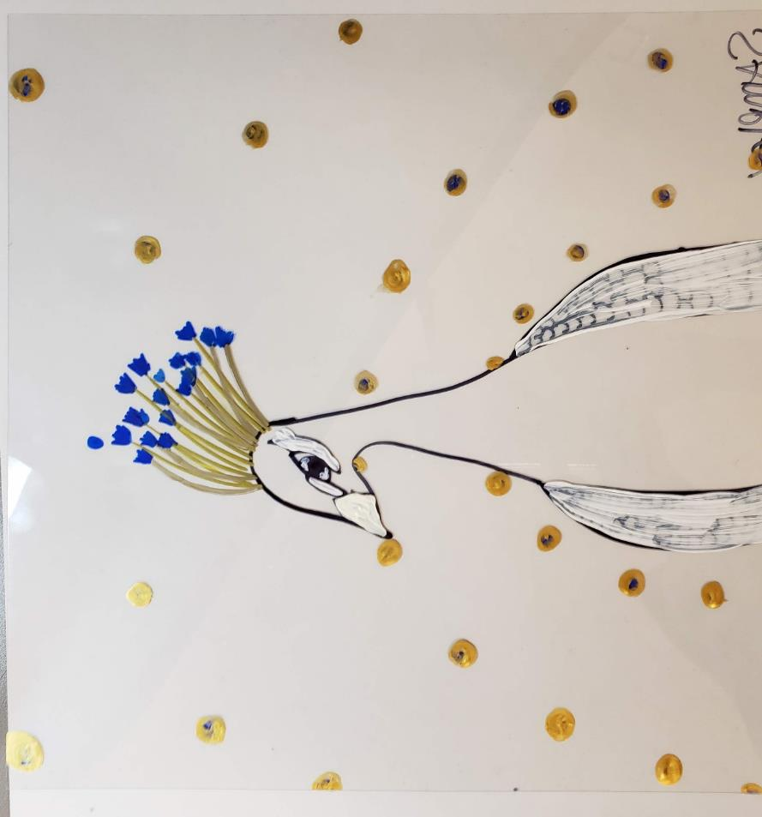
Start the background
Using Dark Blue sharpie make small dots around your peacock. (leave space, these will be the center of your feathers.
Then choose one color to paint over the blue dots (not blue). Maybe pink or seagreen. We also have the pink sharpies.

Slide 14
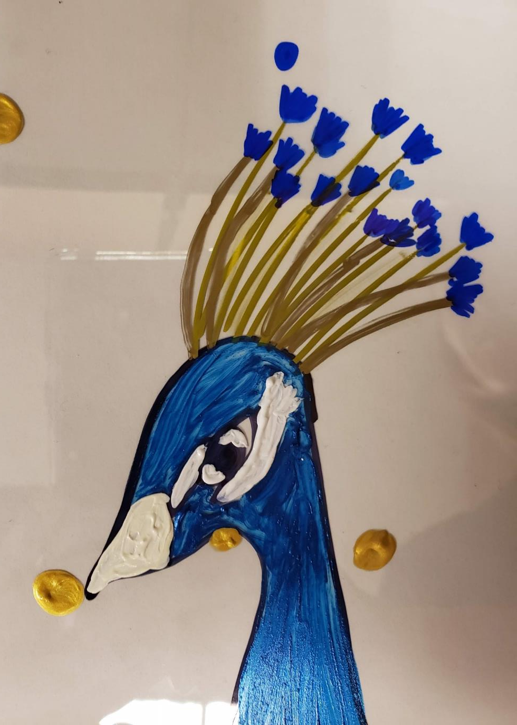
More Eye Detail
Using the White Paint Pens, paint around the eyes and beak.
**Make sure you put your brushes
into the water cup when not in use!
Notes:
Important to encourage students to place brushes in water cup between uses as the acrylic dries quickly and makes clean-up very difficult if paint has dried inside brushes.

Slide 15
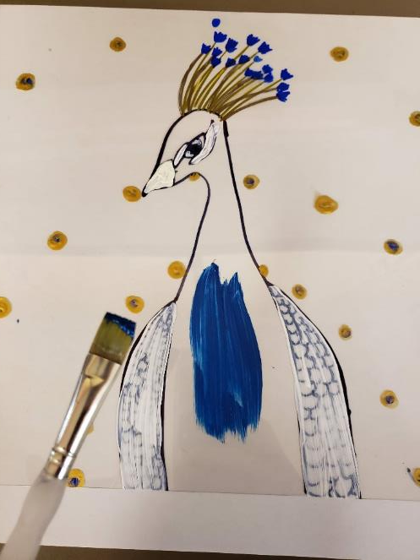
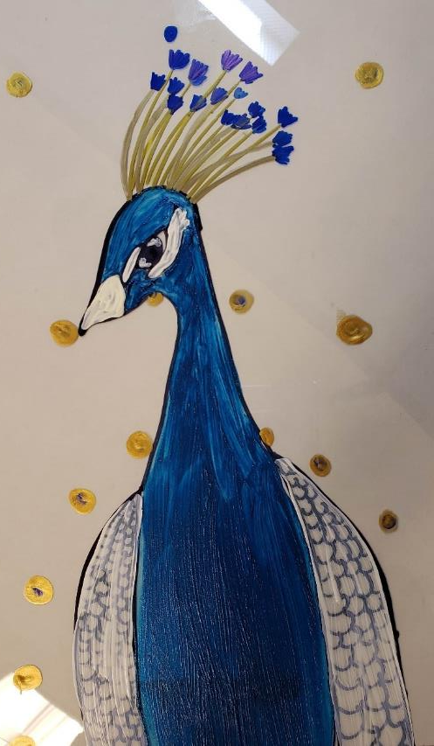
Paint the Body
Use small and medium brushes to fill in the body with Blue Paint.
Start with a small brush and work from the top of the peacock’s head and move down.
When dried add a second coat of blue, the paint is transparent, but after more coats it will look right.
You may need to rotate the plexiglass to prevent your hand from smearing any wet paint.
Notes:
Again, one fairly even coat. It’s okay if brush strokes show.

Slide 16
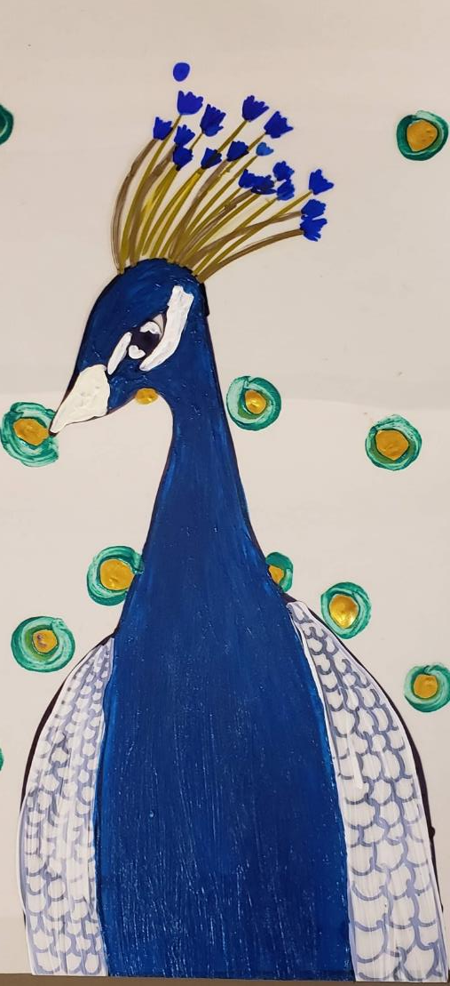
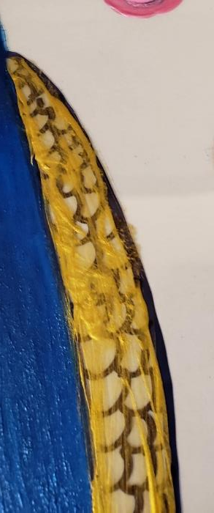
Paint Wing
Using a color that is not Blue paint in the wing.
Notes:
Students are applying one even coat. A second coat will be added when dry.

Slide 17
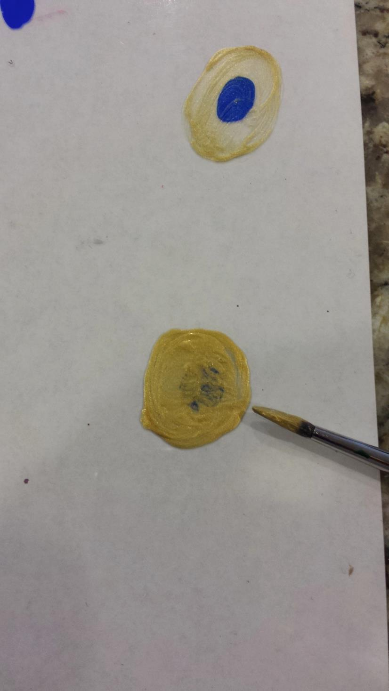
Add a 2nd coat of the color you
chose to the circle.
*you should barely see the
blue circle underneath
Notes:
(First coat will be be dry and second coat should cling well).

Slide 18
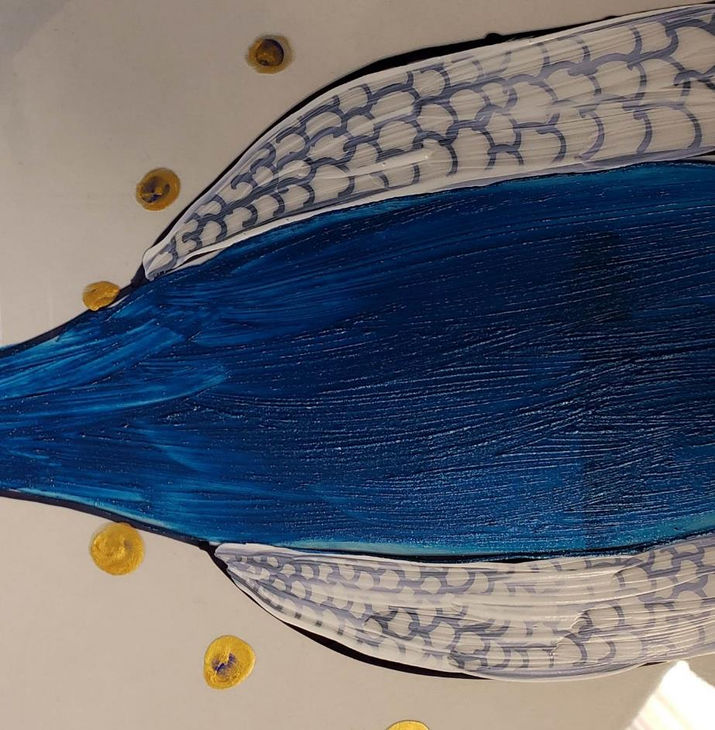
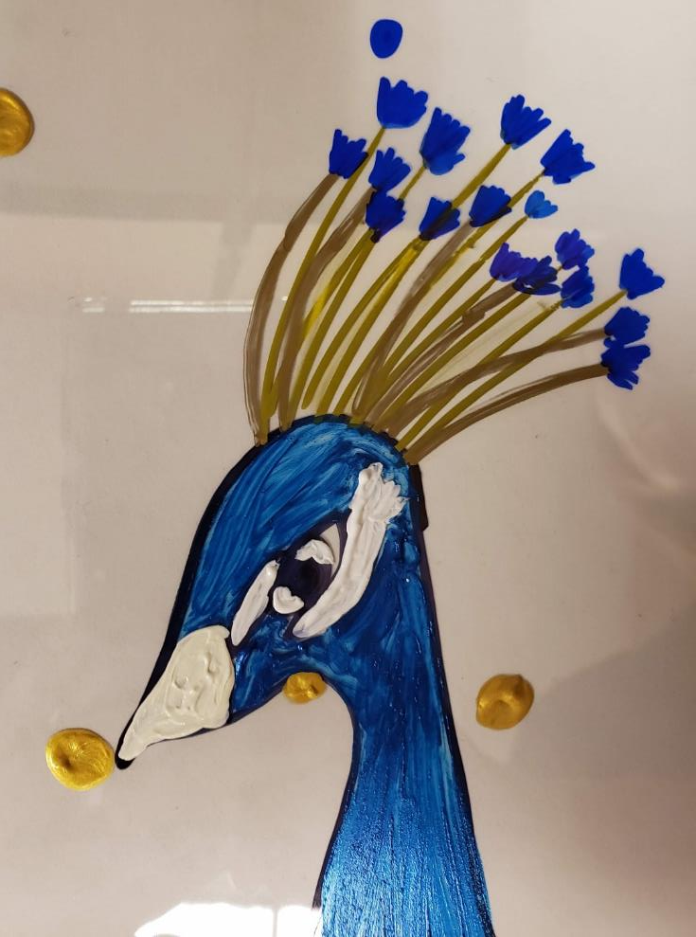
Add a 2nd coat of white to the
area around the eye
and the beak..
Add 2nd coat to the wings.

Slide 19
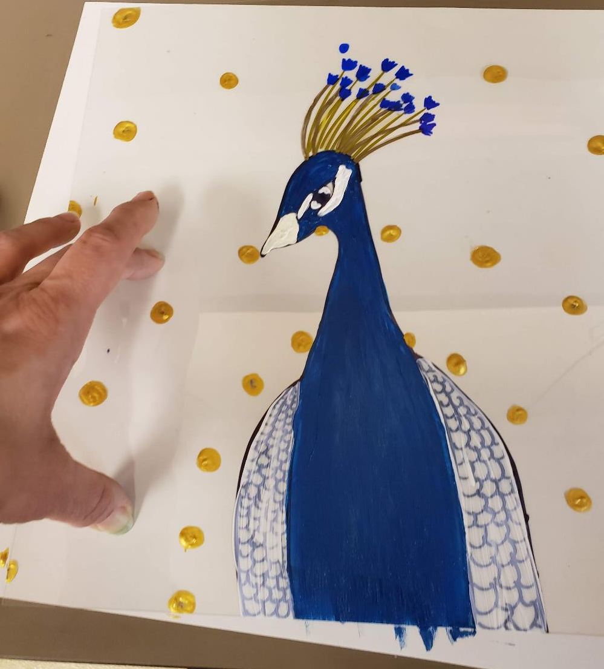
Add your 2nd coat of Blue to the body.
Start at the top of the head again.
Keep your wrist up high and turn the plastic as needed to best reach the small areas.
DO NOT smear your wet dots!
Find a place to hold the plastic down with one hand while you paint the blue. (See picture.)

Slide 20
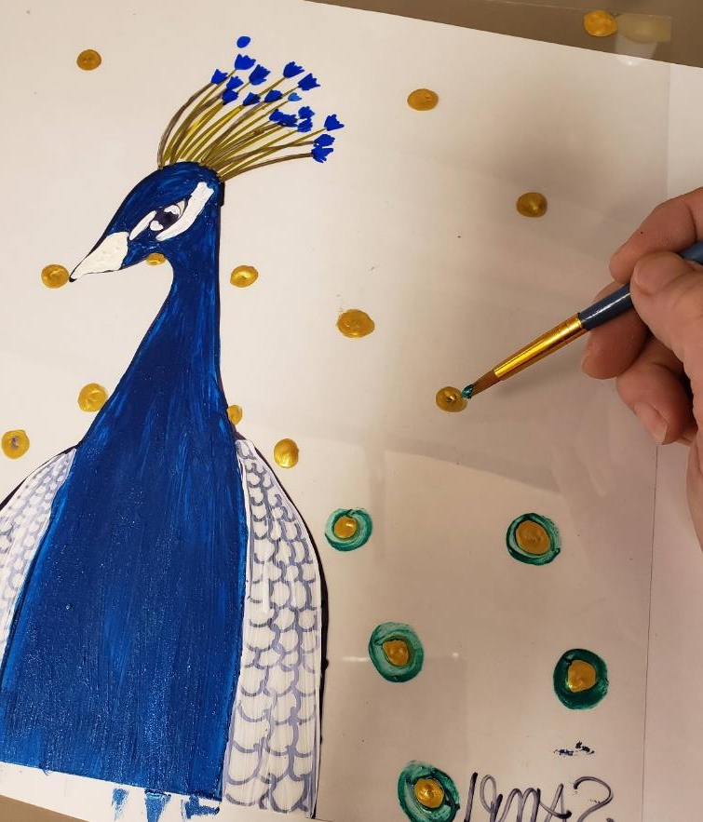
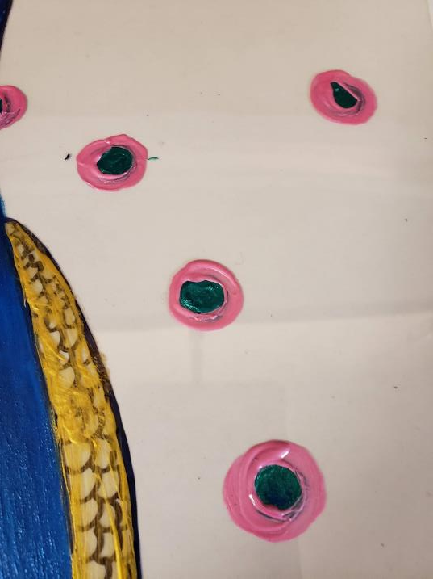
More Dot Detail
Choose a 2nd Color
The dots which will be the feathers.
Holding your brush straight up like a tree, as the previous color may still be wet.
Go slow and do your best not to blend the colors.
If you notice the colors mixing a little, stop and wash and dry your brush.
Notes:
Helpful for one docent or volunteer to carry around two of the colors and another helper can take the other two colors.

Slide 21
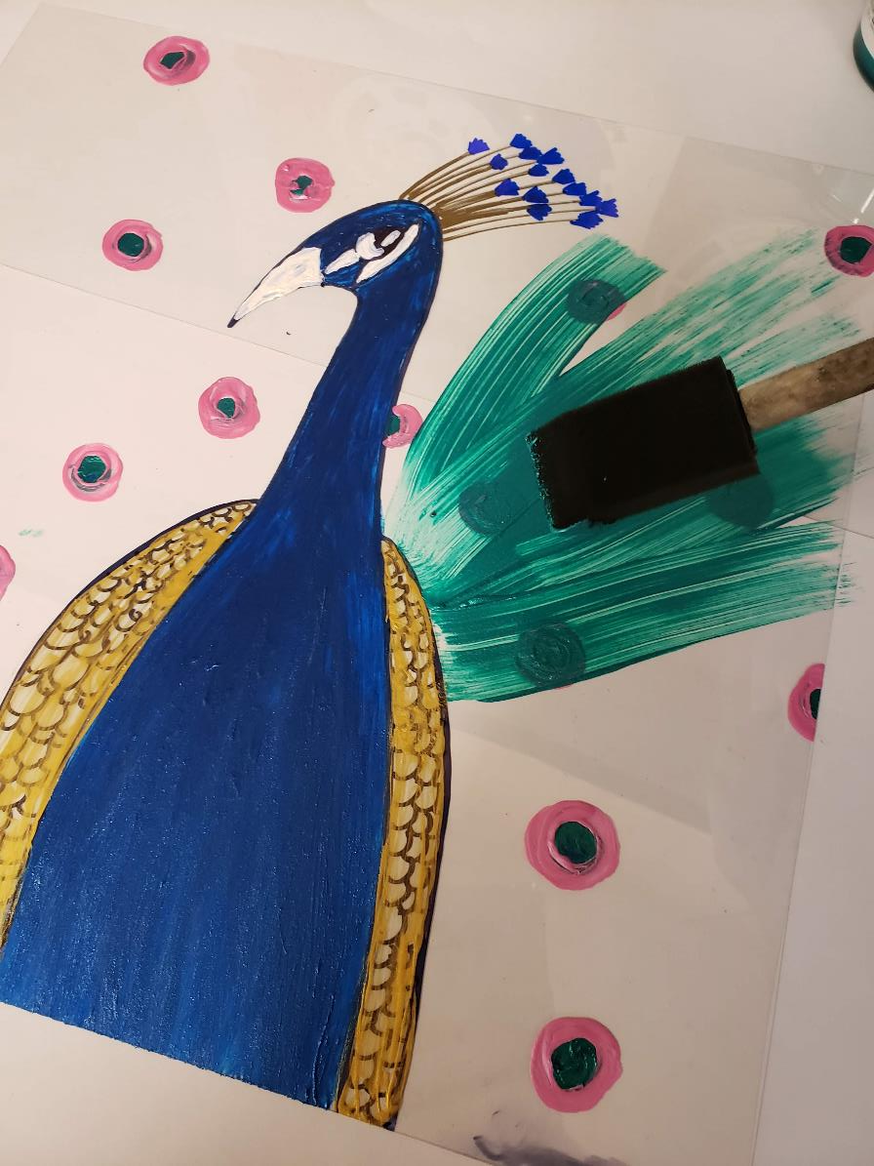
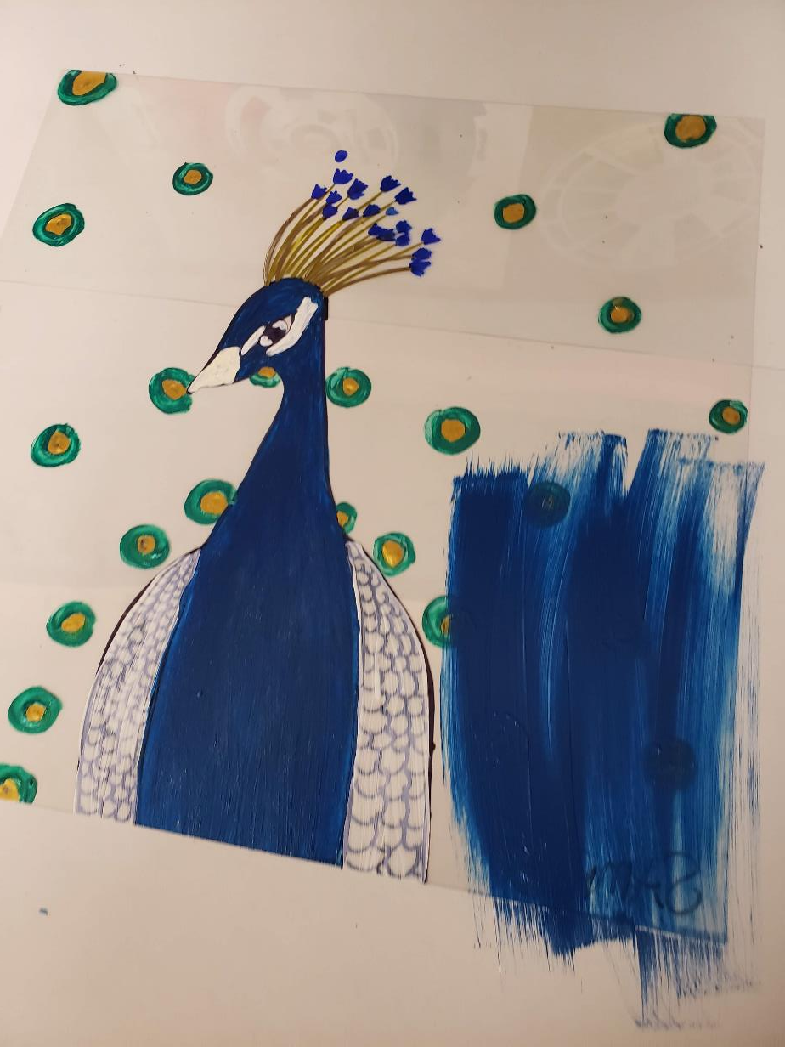
Paint the Background

Slide 22
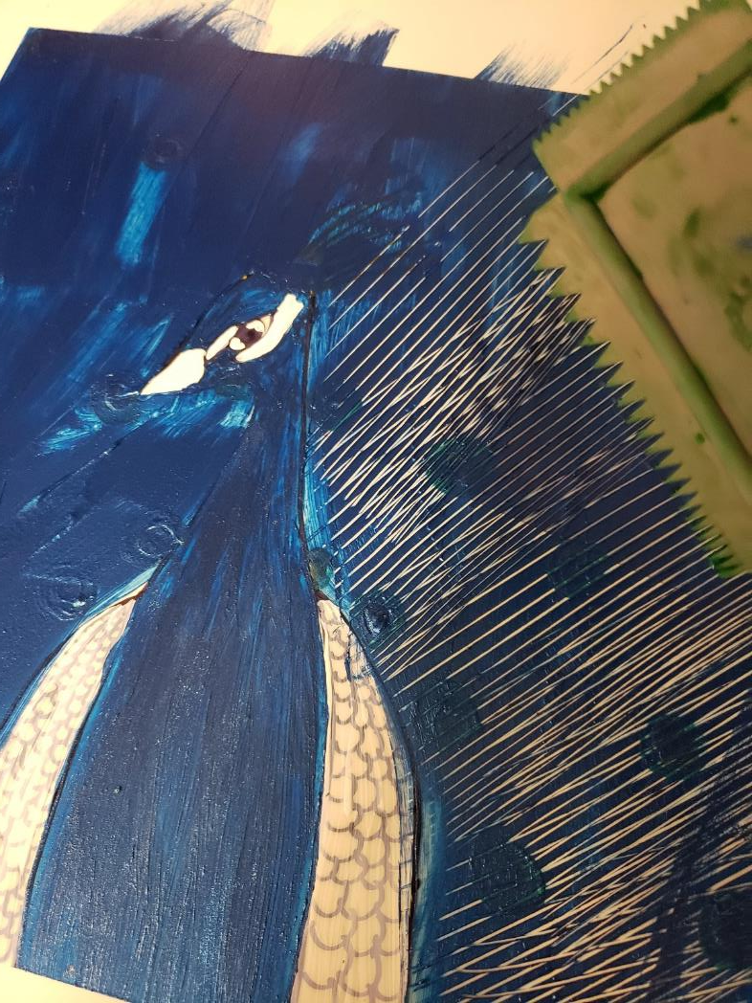
Background Instructions
Once all bird parts and feather details are dry you can begin to paint the background.
With a large brush, choose one color and paint over the feather detail.
Go around the peacock’s wings and head as much as possible, but completely cover the dots and head feathers.
This paint dries quickly, so move quickly.
While paint is wet, use your combing tool to pull the paint from the peacock’s body out to the edge of the plastic sheet. Continue until it is all pulled.
Repeat for a 2nd coat for stronger color.

